Slide 1

CENG 789 – Digital Geometry Processing
14- 3D Printing
Also presented in Eurasia Graphics 2018 Workshop as
3D Printing: Technology and Research
Assoc. Prof. Yusuf Sahillioğlu
Computer Eng. Dept, , Turkey

Slide 2
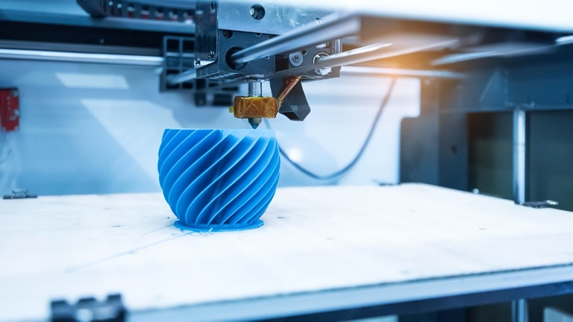
Definition
<number> / 86
Adding material (often in sequential layers) under computer control to create a 3D object.

Slide 3
Definition
<number> / 86
Adding material (often in sequential layers) under computer control to create a 3D object.
An Additive Manufacturing (AM) technology.

Slide 4
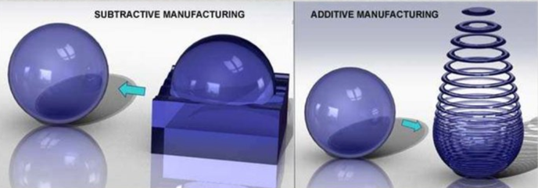
Definition
<number> / 86
Adding material (often in sequential layers) under computer control to create a 3D object.
Opposite Subtractive Manufacturing (SM): remove material from stock.

Slide 5
History
<number> / 86
Despite the recent interest, 3D printing technology dates back to 1981.
Became a hot topic since 2009 when FDM patents (Stratasys) expired.
  Paves the way to innovation in FDM 3D printers.
  Drops desktop 3D printer prices.
  Initiates online 3D printing services (Sculpteo).
  Increases visibility.
FDM not the only AM technique. The first one ('81) was SLA, not FDM.

Slide 6
History
<number> / 86
Despite the recent interest, 3D printing technology dates back to 1981.
  Hideo Kodama, "Automatic method for fabricating a three-dimensional plastic model with photo-hardening polymer," Review of Scientific Instruments, Vol. 52, No. 11, pp. 1770–73, November 1981.
  Resin was polymerized by UV light where UV exposure is controlled by a mask.

Slide 7
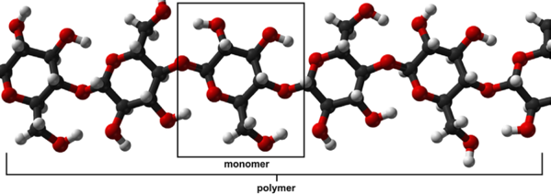
History
<number> / 86
Despite the recent interest, 3D printing technology dates back to 1981.
  Hideo Kodama, "Automatic method for fabricating a three-dimensional plastic model with photo-hardening polymer," Review of Scientific Instruments, Vol. 52, No. 11, pp. 1770–73, November 1981. //Ancestor for the SLA technology.
  Resin was polymerized by UV light where UV exposure is controlled by a mask.
  Polymerization: formation of polymers (many parts) from monomers (one part).
  A monomer is a molecule that has the ability to chemically bond (covalent) with other molecules in a long chain; a polymer is a chain of monomers.

Slide 8
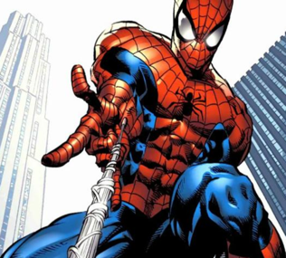
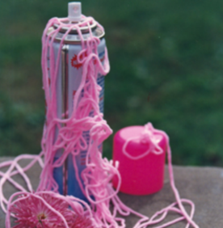
History
<number> / 86
Despite the recent interest, 3D printing technology dates back to 1981.
  Hideo Kodama, "Automatic method for fabricating a three-dimensional plastic model with photo-hardening polymer," Review of Scientific Instruments, Vol. 52, No. 11, pp. 1770–73, November 1981. //Ancestor for the SLA technology.
  Resin was polymerized by UV light where UV exposure is controlled by a mask.
  Polymerization: formation of polymers (many parts) from monomers (one part).
  Spider silk is the strongest natural polymer. String confetti is a synthetic one.

Slide 9
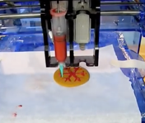
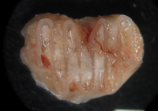
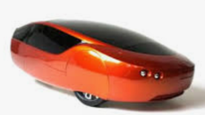
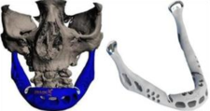
History
<number> / 86
Some recent cool 3D printing activities are
  First 3D printed prototype car by Urbee, 2010
  First 3D food printer by Cornell, 2011
  First 3D printed and implanted prosthetic jaw by Hasselt, 2012
  First 3D printed animal bone using bio-ink by Trinitiy, 2016.

Slide 10
Components
<number> / 86
Uses translational elements to fabricate a digital model.
Bolds: Technologies.
Stage/Tank Material deposition nozzle Ultraviolet laser CO₂ laser Projector
FDM,SLA, FDM SLA SLS SLA/DLP
SLS, DLP

Slide 11
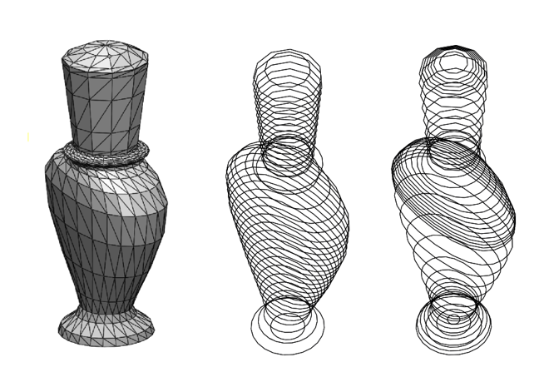
Technology
<number> / 86
FDM: Fused Deposition Modeling.
Begins by slicing 3D digital model into layers.

Slide 12
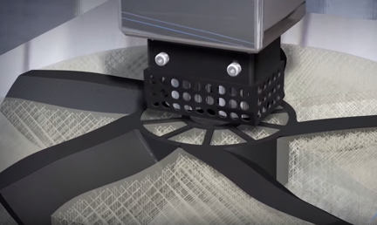
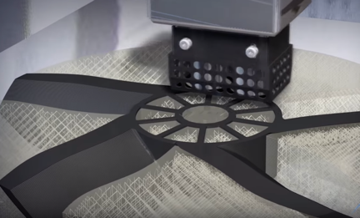
Technology
<number> / 86
FDM: Fused Deposition Modeling.
Begins by slicing 3D digital model into layers.
Material deposition nozzle, aka extrusion nozzle, pours polymeric filament in the horizontal X-Y plane to build the current layer L_{c}.
Filament is cooled down with the fans around nozzle.

Slide 13
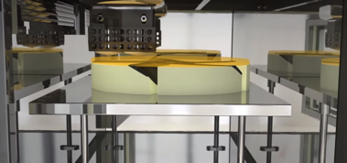
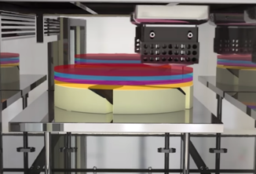
Technology
<number> / 86
FDM: Fused Deposition Modeling.
Begins by slicing 3D digital model into layers.
Material deposition nozzle, aka extrusion nozzle, pours polymeric filament in the horizontal X-Y plane to build the current layer L_{c}.
Filament is cooled down with the fans around nozzle.
Stage, aka build plate, moves down one layer when L_{c} is done.
Principle: Material deposition.
Cool demo: https://youtu.be/WHO6G67GJbM

Slide 14
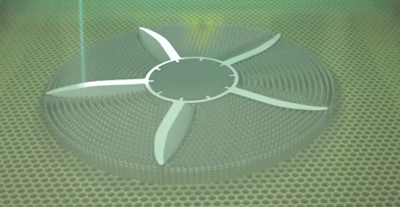
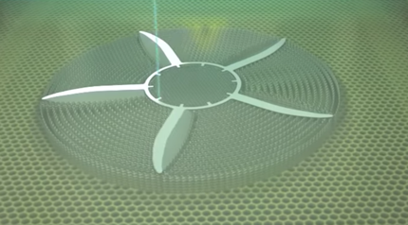
Technology
<number> / 86
SLA: Stereolithography.
Begins by slicing 3D digital model into layers.
Ultraviolet laser is directed (via mirrors) in the horizontal X-Y plane to harden the liquid photopolymer/resin on contact w/ the cross-section to build the current layer L_{c}.

Slide 15
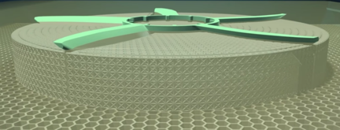
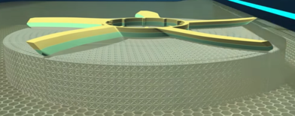
Technology
<number> / 86
SLA: Stereolithography.
Begins by slicing 3D digital model into layers.
Ultraviolet laser is directed (via mirrors) in the horizontal X-Y plane to harden the liquid photopolymer/resin on contact w/ the cross-section to build the current layer L_{c}.
Stage, aka build plate, moves down one layer when L_{c} is done.
Principle: Material solidification.
Cool demo: https://youtu.be/NM55ct5KwiI

Slide 16
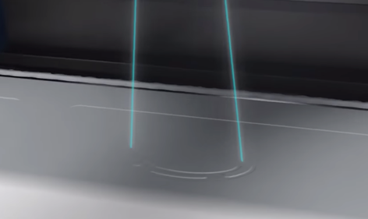
Technology
<number> / 86
SLS: Selective Laser Sintering.
Begins by slicing 3D digital model into layers.
CO₂ laser is directed in the horizontal X-Y plane to fuse the polymer powder on contact w/ the cross-section to build the current layer L_{c}.

Slide 17
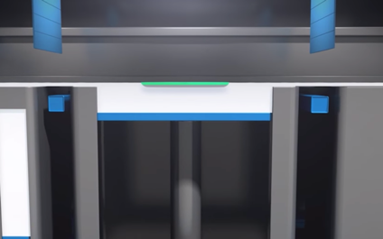
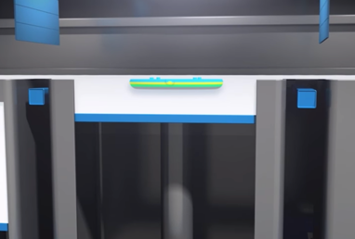
Technology
<number> / 86
SLS: Selective Laser Sintering.
Begins by slicing 3D digital model into layers.
CO₂ laser is directed in the horizontal X-Y plane to fuse the polymer powder on contact w/ the cross-section to build the current layer L_{c}.
Stage, aka build plate, moves down one layer when L_{c} is done.
Principle: Material solidification.
Cool demo: https://youtu.be/9E5MfBAV_tA

Slide 18
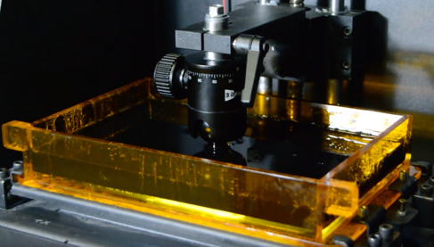
Technology
<number> / 86
SLA/DLP: Direct Light Processing based SLA.
Begins by slicing 3D digital model into layers.
Instead of a continuous path a deposition (FDM) or laser (SLA, SLS), you project a set of contour/cross-section images via DLP projector onto the liquid photopolymer/resin to build the current layer.
Principle: Material solidification.
Cool demo: https://youtu.be/hQ21gbeYFYQ

Slide 19
Technology
<number> / 86
SLA/DLP: Direct Light Processing based SLA.
Begins by slicing 3D digital model into layers.
Instead of a continuous path a deposition (FDM) or laser (SLA, SLS), you project a set of contour/cross-section images via DLP projector onto the liquid photopolymer/resin to build the current layer.
SLA/DLP is raster-based, all other technologies are vector-based.

Slide 20
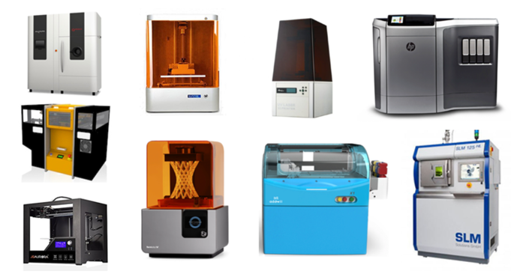
Technology Wrap-Up
<number> / 86
FDM: Fused Deposition Modeling. //polymeric filament, nozzle.
SLA: Stereolithography. //photopolymer: resin, UV laser.
SLS: Selective Laser Sintering. //polymer powder, CO₂ laser.
SLA/DLP: DLP-based SLA. //photopolymer: resin, image.

Slide 21
Technology Wrap-Up
<number> / 86
FDM: Fused Deposition Modeling. //polymeric filament, nozzle.
SLA: Stereolithography. //photopolymer: resin, UV laser.
SLS: Selective Laser Sintering. //polymer powder, CO₂ laser.
SLA/DLP: DLP-based SLA. //photopolymer: resin, image.
Go with FDM for multi-material/color (deposition).

Slide 22
Technology Wrap-Up
<number> / 86
FDM: Fused Deposition Modeling. //polymeric filament, nozzle.
SLA: Stereolithography. //photopolymer: resin, UV laser.
SLS: Selective Laser Sintering. //polymer powder, CO₂ laser.
SLA/DLP: DLP-based SLA. //photopolymer: resin, image.
Go with FDM for multi-material/color (deposition).
Go with FDM for fully closed empty voids (non-solidified material gets trapped there in the other technologies).

Slide 23
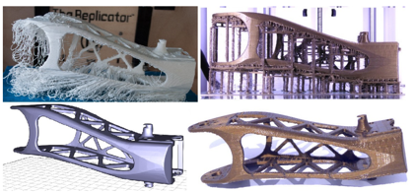
Technology Wrap-Up
<number> / 86
FDM: Fused Deposition Modeling. //polymeric filament, nozzle.
SLA: Stereolithography. //photopolymer: resin, UV laser.
SLS: Selective Laser Sintering. //polymer powder, CO₂ laser.
SLA/DLP: DLP-based SLA. //photopolymer: resin, image.
Go with FDM for multi-material/color (deposition).
Go with FDM for fully closed empty voids (non-solidified traps there).
Go with SLS, SLA, SLA/DLP for complex geometries (creation and removal of support structures are problematic and inevitable in FDM).
Without support,
overhangs fall ➔
3D input model ➔
Sacrificial external
support structure, and
model after its removal.

Slide 24
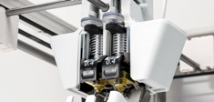
Technology Wrap-Up
<number> / 86
FDM: Fused Deposition Modeling. //polymeric filament, nozzle.
SLA: Stereolithography. //photopolymer: resin, UV laser.
SLS: Selective Laser Sintering. //polymer powder, CO₂ laser.
SLA/DLP: DLP-based SLA. //photopolymer: resin, image.
Go with FDM for multi-material/color (deposition).
Go with FDM for fully closed empty voids (non-solidified traps there).
Go with SLS, SLA, SLA/DLP for complex geometries (creation and removal of support structures are problematic and inevitable in FDM).
Dual-nozzle 3D FDM printers w/ soluble support material available.

Slide 25
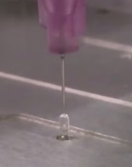
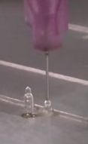
Technology Wrap-Up
<number> / 86
FDM: Fused Deposition Modeling. //polymeric filament, nozzle.
SLA: Stereolithography. //photopolymer: resin, UV laser.
SLS: Selective Laser Sintering. //polymer powder, CO₂ laser.
SLA/DLP: DLP-based SLA. //photopolymer: resin, image.
Go with FDM for multi-material/color (deposition).
Go with FDM for fully closed empty voids (non-solidified traps there).
Go with SLS, SLA, SLA/DLP for complex geometries (creation and removal of support structures are problematic and inevitable in FDM).
New techs can print out-of-plane (doable with
FDM if you manage to avoid nozzle hitting an
already printed part): youtu.be/NWBa8OWgApM

Slide 26
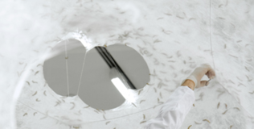
Technology Wrap-Up
<number> / 86
FDM: Fused Deposition Modeling. //polymeric filament, nozzle.
SLA: Stereolithography. //photopolymer: resin, UV laser.
SLS: Selective Laser Sintering. //polymer powder, CO₂ laser.
SLA/DLP: DLP-based SLA. //photopolymer: resin, image.
Go with FDM for multi-material/color (deposition).
Go with FDM for fully closed empty voids (non-solidified traps there).
Go with SLS, SLA, SLA/DLP for complex geometries (creation and removal of support structures are problematic and inevitable in FDM).
New techs can print out-of-plane (FDM logic;
a biological fabrication technique via silkworms):
https://youtu.be/0ePriBJKYt8

Slide 27
Technology Wrap-Up
<number> / 86
FDM: Fused Deposition Modeling. //polymeric filament, nozzle.
SLA: Stereolithography. //photopolymer: resin, UV laser.
SLS: Selective Laser Sintering. //polymer powder, CO₂ laser.
SLA/DLP: DLP-based SLA. //photopolymer: resin, image.
Go with FDM for multi-material/color (deposition).
Go with FDM for fully closed empty voids (non-solidified traps there).
Go with SLS, SLA, SLA/DLP for complex geometries (creation and removal of support structures are problematic and inevitable in FDM).
New techs can print out-of-plane (doable with FDM if you manage to avoid nozzle hitting an already printed part).
Print time depends on part volume in FDM, part height in others (‘cos constant sweeptime requird per layer); they’re bad for single small obj.

Slide 28
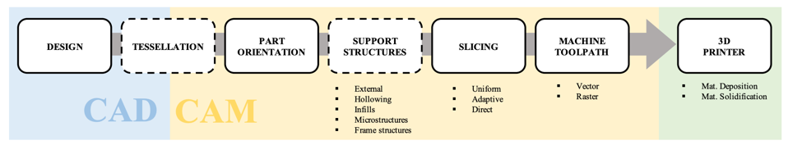
Product Development Pipeline
<number> / 86
Figure from: Livesu et al., 2017, From 3D models to 3D prints: an overview of the processing pipeline.

Slide 29

Process Planning Pipeline (Yellow Part)
<number> / 86
We assume that product concept, e.g., Armadillo, is already designed, e.g., by a CAD expert, without knowing whether it’ll be printed or not.
We will go through each single step in Process Planning (PP) pipeline (dashed boxes optional) that prepares the 3D model for fabrication.
  PP: After design and before actual manufacturing.

Slide 30
Process Planning Pipeline in a Nutshell
<number> / 86
Update the mesh to comply with the input representation requirements.
  Tessellated geometry must be watertight: enclose a solid: no water leakage.

Slide 31
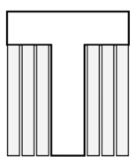
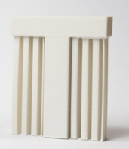
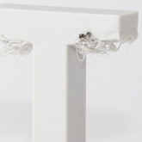
Process Planning Pipeline in a Nutshell
<number> / 86
Update the mesh to comply with the input representation requirements.
  Tessellated geometry must be watertight: enclose a solid: no water leakage.
Orient optimally to minimize print time, support need, .. or fit chamber.
Should have been Sagged result
upside-down T. without support.

Slide 32
Process Planning Pipeline in a Nutshell
<number> / 86
Update the mesh to comply with the input representation requirements.
  Tessellated geometry must be watertight: enclose a solid: no water leakage.
Orient optimally to minimize print time, support need, .. or fit chamber.
Should have been Sagged result
upside-down T. without support.
Create support structures (if FDM in use).

Slide 33

Process Planning Pipeline in a Nutshell
<number> / 86
Update the mesh to comply with the input representation requirements.
  Tessellated geometry must be watertight: enclose a solid: no water leakage.
Orient optimally to minimize print time, support need, .. or fit chamber.
Should have been Sagged result
upside-down T. without support.
Create support structures (if FDM in use).
Slice the model uniformly or adaptively.

Slide 34

Process Planning Pipeline in a Nutshell
<number> / 86
Update the mesh to comply with the input representation requirements.
  Tessellated geometry must be watertight: enclose a solid: no water leakage.
Orient optimally to minimize print time, support need, .. or fit chamber.
Should have been Sagged result
upside-down T. without support.
Create support structures (if FDM in use).
Slice the model uniformly or adaptively.
Convert each slice to a toolpath (vector) or grid of solid pixels (raster).

Slide 35
Audience
<number> / 86
People who contribute to the PP pipeline in the context of AM:
  Computer graphics experts.
  Mechanical engineers.
  Material scientists.
  Mathematicians.

Slide 36
AM vs. SM
<number> / 86
PP in traditional SM, such as CNC machining, is complex, e.g., experienced skilled manufacturer needed.
PP in AM is mostly algorithmic.
Also notice the significantly less material waste in AM.

Slide 37
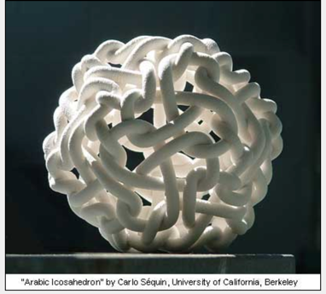
AM vs. SM
<number> / 86
AM enables fabrication of shapes that cannot be done with SM.
  Shapes that were interesting from a theoretical pnt can now be printed and their functionality can now be exploited.
  Made possible because 2D toolpaths are generated (within each slice) instead of complex 3D paths.

Slide 38
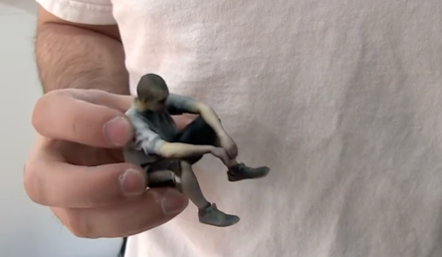
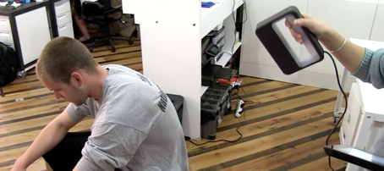
AM vs. SM
<number> / 86
AM is excellent for customization.
  3D scan yourself or any other thing, manipulate digitally (optional), fabricate.
  Geometry Processing pipeline involved consists of acquisition, registration, reconstruction, remeshing, and smoothing. These steps and more are covered in our course CENG 789. https://youtu.be/K6xgsscQac8

Slide 39
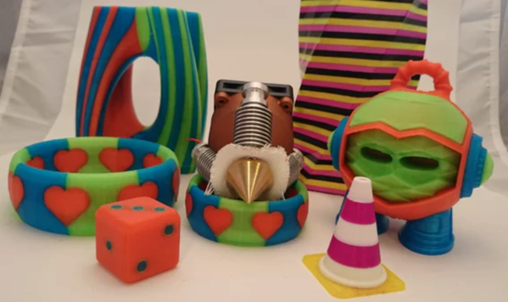
AM vs. SM
<number> / 86
AM is practical for multi-color and multi-material production.

Slide 40
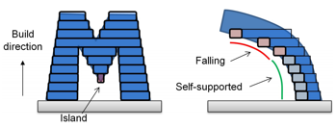
AM vs. SM
<number> / 86
Drawbacks of AM also exist.
  Limited part sizes, fabrication speed, materials.
  Poor surface finish.
  High cost.
  Gravity effective during manufacturing (overhangs/islands must be supported).
So go with SM if you need many (speed) precise (surface finish) items.
Or go with AM if you need highly complex and intricate items, e.g., those that require a hollow interior (to save weight or material).

Slide 41
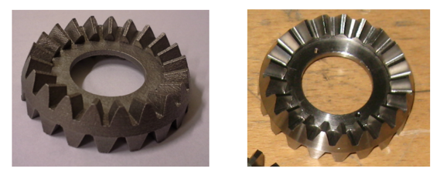
AM vs. SM
<number> / 86
Drawbacks of AM also exist.
  Limited part sizes, fabrication speed, materials.
  Poor surface finish.
  High cost.
  Gravity effective during manufacturing (overhangs/islands must be supported).
Better yet, go with a hybrid solution: AM and SM together.
Surface finish achieved by AM (left) is improved with SM (right, milling).

Slide 42
Tuning PP Pipeline
<number> / 86
PP can be tuned to optimize for one or a combination of objectives.
  Cost.
  Fidelity.
  Functionality.

Slide 43
Tuning PP Pipeline - Cost
<number> / 86
Minimize Pre-build Cost + Build Cost + Post-processing Cost.

Slide 44
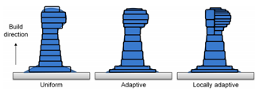
Tuning PP Pipeline - Cost
<number> / 86
Minimize Pre-build Cost + Build Cost + Post-processing Cost.
Cost to turn a design into a set of printer instructions.
  Efficient algorithms, e.g., slicing:
  Reduced user interaction.
Labor cost.
  Load print material, e.g., powder.
  Clean and warm up printer.
  Deal with printer software, e.g., Cura.

Slide 45
Tuning PP Pipeline - Cost
<number> / 86
Minimize Pre-build Cost + Build Cost + Post-processing Cost.
Printing time.
  Efficient algorithms, e.g., orientation.
  Reduced user interaction.
Material cost.
  Reduce material waste.
  Structural strength may degrade to use less mat.: bad for industrial production.
Support structure amount affects
both printing time and material cost.
Can be computed by the sum of the volumes of the prisms generated by extruding the down-facing triangles up to the building plate.

Slide 46
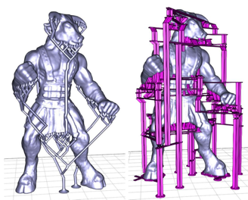
Tuning PP Pipeline - Cost
<number> / 86
Minimize Pre-build Cost + Build Cost + Post-processing Cost.
Printing time.
  Efficient algorithms, e.g., orientation.
  Reduced user interaction.
Material cost.
  Reduce material waste.
  Structural strength may degrade to use less mat.: bad for industrial production.
Support structure amount affects
both printing time and material cost.
Can be reduced by employing tree- or
scaffold-based structures.
  Bridging the Gap: Automated Steady Scaffoldings for 3D Printing, 2014.

Slide 47
Tuning PP Pipeline - Cost
<number> / 86
Minimize Pre-build Cost + Build Cost + Post-processing Cost.
Polishing time.
  Detach supports.
  Chemical, mechanical or manual surface finishing.

Slide 48
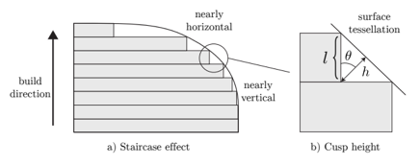
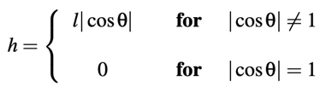
Tuning PP Pipeline - Fidelity
<number> / 86
How perfect the replica is?
Form fidelity: difference in shape b/w design and production.
Layers piled along building direction causes staircase effect ➔ fidelity
Cusp-height error measures form fidelity.
|cosϴ| grows as ϴ decreases (see nearly horizontal part above).

Slide 49
Tuning PP Pipeline - Fidelity
<number> / 86
How perfect the replica is?
Form fidelity: difference in shape b/w design and production.
Layers piled along building direction causes staircase effect ➔ fidelity
Cusp-height error measures form fidelity.
Integral of cusp-height before printing (build direction b): for each face w/ normal n, |cosϴ| = | b ᐧ n|. Add these errors (more for horizontal).

Slide 50
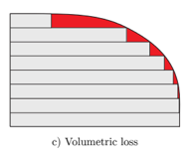
Tuning PP Pipeline - Fidelity
<number> / 86
How perfect the replica is?
Form fidelity: difference in shape b/w design and production.
Layers piled along building direction causes staircase effect ➔ fidelity
Volumetric loss measures form fidelity.
Red area above.
Similar to cusp-height, compute before printing.

Slide 51
Tuning PP Pipeline - Fidelity
<number> / 86
How perfect the replica is?
Texture fidelity: tiny local variations over the printed surface.
Unlike form fidelity, computed after printing (using sampling schemes).
Aka surface finish.
To obtain better fidelity, meniscus smoothing or support hiding popular.

Slide 52
Tuning PP Pipeline - Fidelity
<number> / 86
How perfect the replica is?
Texture fidelity: tiny local variations over the printed surface.
Unlike form fidelity, computed after printing (using sampling schemes).
Aka surface finish.
To obtain better fidelity, meniscus smoothing or support hiding popular.
Lift the solidified layer above the upper surface of the resin tank to stretch a meniscus of liquid b/w each layer ➔ smoother transition.

Slide 53
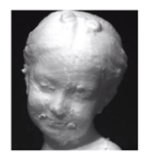
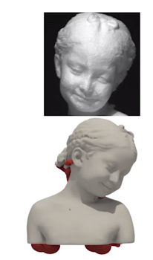
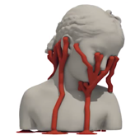
Tuning PP Pipeline - Fidelity
<number> / 86
How perfect the replica is?
Texture fidelity: tiny local variations over the printed surface.
Unlike form fidelity, computed after printing (using sampling schemes).
Aka surface finish.
To obtain better fidelity, meniscus smoothing or support hiding popular.
Place supports at the least salient parts
so that removal artifacts are hidden.

Slide 54
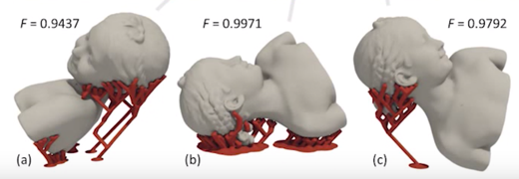
Tuning PP Pipeline - Fidelity
<number> / 86
How perfect the replica is?
Texture fidelity: tiny local variations over the printed surface.
Unlike form fidelity, computed after printing (using sampling schemes).
Aka surface finish.
To obtain better fidelity, meniscus smoothing or support hiding popular.
Place supports at the least salient parts
so that removal artifacts are hidden.

Slide 55
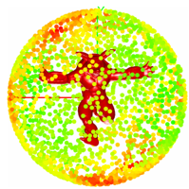
Tuning PP Pipeline - Fidelity
<number> / 86
How perfect the replica is?
Texture fidelity: tiny local variations over the printed surface.
Unlike form fidelity, computed after printing (using sampling schemes).
Aka surface finish.
To obtain better fidelity, meniscus smoothing or support hiding popular.
To find building direction: i) consider a small # of candid orientations (predefined or computed on convex hull), ii) shortlist from a regular sampling of orientations.
Perceptual models of preference in 3d printing direction, 2015; Improved Surface Quality in 3D Printing by Optimizing the Printing Direction, 2016.

Slide 56
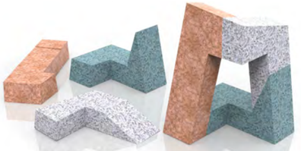
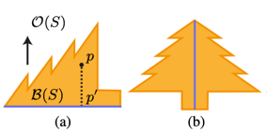
Tuning PP Pipeline - Fidelity
<number> / 86
How perfect the replica is?
Texture fidelity: tiny local variations over the printed surface.
Unlike form fidelity, computed after printing (using sampling schemes).
Aka surface finish.
To obtain better fidelity, meniscus, support hiding, or self-supports.
Split model into approximtely pyramidal parts that support themselves.
Approximate Pyramidal Shape Decomposition, 2014.

Slide 57
Tuning PP Pipeline - Functionality
<number> / 86
Optimize shape to comply with some functional requirements.
  Robustness: insensitive to known or unknown forces.
  Mass distribution: achieve static or dynamic equilibrium.
  Light/sound propagation: guide light/sound inside the object.

Slide 58




Tuning PP Pipeline - Functionality
<number> / 86
Optimize shape to comply with some functional requirements.
  Robustness: insensitive to known or unknown forces.
  Input: &
  Output: probability of failure/fraction &
  location of common point of failures.
  Stochastic Structural Analysis For Context-Aware Design And Fabrication, 2016.

Slide 59


Tuning PP Pipeline - Functionality
<number> / 86
Optimize shape to comply with some functional requirements.
  Robustness: insensitive to known or unknown forces.
  Optimal orientation that will result in an as-strong-as-possible 3D print. Weak sections are identified and up direction for printing is determined accordingly.
  Cross-sectional Structural Analysis for 3D Printing Optimization, 2013.

Slide 60

Tuning PP Pipeline - Functionality
<number> / 86
Optimize shape to comply with some functional requirements.
  Robustness: insensitive to known or unknown forces.
  Elastic objs deform under gravity after printing. Take this into account beforehand.
  An Asymptotic Numerical Method for Inverse Elastic Shape Design, 2014.

Slide 61





Tuning PP Pipeline - Functionality
<number> / 86
Optimize shape to comply with some functional requirements.
  Mass distribution: achieve static or dynamic equilibrium.
  Make an object stand, spin, or float after fabrication by distributing cavities inside.
  Make It Stand: Balancing Shapes for 3D Fabrication, 2013; Spin-It: Optimizing Moment of Inertia for Spinnable Objects, 2014. Buoyancy optimization for computational fabrication, 2016.

Slide 62

Tuning PP Pipeline - Functionality
<number> / 86
Optimize shape to comply with some functional requirements.
  Mass distribution: achieve static or dynamic equilibrium.
  Topology optimization to get low weight to strength ratios, e.g., for aerospace.

Slide 63

Tuning PP Pipeline - Functionality
<number> / 86
Optimize shape to comply with some functional requirements.
  Mass distribution: achieve static or dynamic equilibrium.
  Topology optimization to get low weight to strength ratios, e.g., for aerospace.
  More interior Voronoi sites around the weaker regions (non-blue) would lead to more Voronoi cells/edges to be printed on those vulnerable parts. Regions that don’t carry lot of stress (blue) aren’t prone to break so larger cells there (less sites).
  Built-to-last: strength to weight 3D printed objects, 2014.

Slide 64



Tuning PP Pipeline - Functionality
<number> / 86
Optimize shape to comply with some functional requirements.
  Light/sound propagation: guide light/sound inside the object.
  Multi-material printing to fabricate curved displays w/ embedded optical fibers.
  Computational light routing: 3d printed optical fibers for sensing and display, 2014.

Slide 65

Tuning PP Pipeline - Functionality
<number> / 86
Optimize shape to comply with some functional requirements.
  Light/sound propagation: guide light/sound inside the object.
  Natural frequency optimization to make object sound in a controlled manner.
  Non-Linear Shape Optimization Using Local Subspace Projections, 2016.

Slide 66



Input Requirements
<number> / 86
Printing technology is for solid objects: tessellation.
A raw point cloud, e.g. 3D scan result, must be tessellated into a mesh.
There exist books on the subject. See also Surface Reconstruction lect.
. . . .

Slide 67

Input Requirements
<number> / 86
Printing technology is for solid objects: tessellation.
A raw point cloud, e.g. 3D scan result, must be tessellated into a mesh.
Here is a simple algorithm:
Find local neighborhood L_{i} of each point p_{i} in the 3D point cloud input.
  Closest k points (using a k-d tree).
For each L_{i} compute tangent plane using PCA.
Project all points in L_{i} to the tangent plane and compute their 2D Delaunay triangulation D_{i}.

Slide 68

Input Requirements
<number> / 86
Printing technology is for solid objects: tessellation.
A raw point cloud, e.g. 3D scan result, must be tessellated into a mesh.
Here is a simple algorithm:
D_{i} is a set of edges: D_{i} = {e_{i}¹, e_{i}², .., e_{i}^{noe(i)} } where noe(i) where is the number of edges of the i^{th} Delaunay triangulation.
Final triangulation is the composition of all N local triangulations:
Note that global D not necessarily a 2-manifold. Set k = 0.02n and restrict value to [8,12].

Slide 69



Input Requirements
<number> / 86
Printing technology is for solid objects: tessellation.
A raw point cloud, e.g. 3D scan result, must be tessellated into a mesh.
Here is a popular algorithm:
Previous algorithm performed an explicit reconstruction.
Marching cubes is an implicit method that extracts the zero-set of a scalar function, commonly a signed distance function F(x) = (x - o_{i}) ᐧ n_{i}
  Marching Cubes: A high resolution 3D surface construction algorithm, 1987.

Slide 70


Input Requirements
<number> / 86
Printing technology is for solid objects: watertight meshes.
Manifold meshes: keep things simple.
  Images: assume every pixel has 4 neighbors. Likewise, assume meshes are manifold. It keeps formulas simple and leads to fewer special cases in code.
    Edges are contained in at most 2 polygonal faces.
    Vertices are contained in disk of triangles.
Watertight meshes are 2-manifold meshes w/o boundary edges.
No holes or non-manifold structures.
Closed mesh (no boundary edges).
Imagine filling the inside of the mesh
w/ water, would anything leak out? If not,
then chances are the mesh is watertight.

Slide 71


Input Requirements
<number> / 86
Printing technology is for solid objects: watertight meshes.
Thicken sheet-like structures to make them printable: surface-to-solid.
  Extrude each vertex along its normal direction (both positive and negative) by a default offset defining the shell thickness.

Slide 72

Input Requirements
<number> / 86
Printing technology is for solid objects: watertight meshes.
Fill holes to ensure that the resulting mesh encloses a solid.
  MeshLab software: Filters → Fill Holes. Paper: Filling Holes, P. Liepa, SGP, 2003.

Slide 73





<number> / 86
Printing technology is for solid objects: watertight meshes.
Filling Holes in Meshes, 2003.
  Triangulate (coarse).
    n vertex → n-2 triangles (dynamic programming (DP)).
  Refine.
    Subdivide triangles to reduce edge lengths to avg edge length at the hole boundary.
    Flip interior edges if flipping maximizes min angle (Delaunay).
  Smooth.
    Mesh fairing.

Slide 74



Input Requirements
<number> / 86
Printing technology is for solid objects: watertight meshes.
Coarse triangulation T that minimizes area sum + max dihedral angle.
Let w[a,c] be the min weight/cost that can be achieved in triangulating the polygon a, a+1, .., c. Final output by w[0, n-1]. To get there, intermediate steps like w[2,9] will be filled and stored in the DP table.
........ next slide →

Slide 75






Input Requirements
<number> / 86
Printing technology is for solid objects: watertight meshes.
Coarse triangulation T that minimizes area sum + max dihedral angle.
Let w[a,c] be the min weight/cost that can be achieved in triangulating the polygon a, a+1, .., c.
w[a,c] = min w[a,b] + w(⍙abc) + w[b,c]
w[x,x+1] = 0
w(⍙abc) = area(a,b,c) yields min area T.
crenellation triangles duplicated ☹.
Sharp folds and non-manifold edges.

Slide 76


Input Requirements
<number> / 86
Printing technology is for solid objects: watertight meshes.
Coarse triangulation T that minimizes area sum + max dihedral angle.
Let w[a,c] be the min weight/cost that can be achieved in triangulating the polygon a, a+1, .., c.
w(⍙abc) = area(a,b,c) plus max dihedral angle b/w a,b,c and existing adj. triangls that exist at the time of evaluation.
dihedral:

Slide 77


Shape Requirements
<number> / 86
Printing technology is for moderate-size shapes that fits into chamber.
Split big model into parts that can be printed separately & assembled.
  Chopper: Partitioning Models into 3D-Printable Parts, 2012; CofiFab: Coarse-to-Fine Fabrication of Large 3D Objects, 2016.

Slide 78

Shape Requirements
<number> / 86
Printing technology is for moderate-size shapes that fits into chamber.
A related issue is to compute the tight arrangement of the parts within a container to be shipped for reassembly in the destination.
  Shapes In a Box: Disassembling 3D Objects for Efficient Packing and Fabrication, 2015.

Slide 79


Shape Interior
<number> / 86
Is a key factor regarding material use and print time.
Inner volume grows to the cube of scaling factor, e.g., doubling object size multiplies its volume by 2³=8.
  This explains interior’s impact on material use and print time.
  Varying elasticity can be achieved, e.g., by using different interior microstructs.

Slide 80




Shape Interior
<number> / 86
Is a key factor regarding material use and print time.
Inner volume grows to the cube of scaling factor, e.g., doubling object size multiplies its volume by 2³=8.
  This explains interior’s impact on material use and print time.
  Varying elasticity can be achieved, e.g., by using different interior microstructs.
  Microstructures to Control Elasticity in 3D Printing, 2015.

Slide 81

Shape Interior
<number> / 86
Is a key factor regarding material use and print time.
Aka interior support, infill.
Raster device: produce an image of the filled layer contour; project it.
Vector device: trickier. Nozzle/laser must follow a space filling curve when depositing/solidifying material.
Fermat spiral: Reduce # of sharp turns to enable faster motions and remove vibrations (beats the most common Dir parallel and Hilbert). Continuous to prevent stops and restarts (beats Con parallel).
  Connected Fermat spirals for layered fabrication, 2016. 17th century idea in 21st century.

Slide 82

Shape Interior
<number> / 86
Is a key factor regarding material use, print time, mechanical props.
Aka interior support, infill.
Raster device: produce an image of the filled layer contour; project it.
Vector device: trickier. Nozzle/laser must follow a space filling curve when depositing/solidifying material.
  Connected Fermat spirals for layered fabrication, 2016. 17th century idea in 21st century.

Slide 83

Potential Project Topics / Future Work
<number> / 86
An important open question: can we design shapes with AM in mind?
3D printing algorithms work on a 3D shape that is designed without AM in mind and aim to find the best way to print it to match one or some of the criteria: Cost, Fidelity, Functionality.
It’d be better if we consider these issues during 3D design, not after.
  Interactive Modeling of Support-free Shapes for Fabrication, 2016.

Slide 84

Potential Project Topics / Future Work
<number> / 86
An important open question: design shapes with AM in mind?
3D printing algorithms work on a 3D shape that is designed without AM in mind and aim to find the best way to print it to match one or some of the criteria: Cost, Fidelity, Functionality.
  SLA FDM
  Support Slimming for Single Material Based Additive Manufacturing, 2015.

Slide 85


Potential Project Topics / Future Work
<number> / 86
An important open question: put structures on to the surface?
For esthetic, stability, fast prototyping.
Current work: manual, labor-intensive, skill-based, curve primitives.
Future work: extract patterns directly from the existing mesh facets?
  Designing Structurally-Sound Ornamental Curve Networks, 2016.

Slide 86

Potential Project Topics / Future Work
<number> / 86
An important open question: 4D printing?
Metamaterials that are able to morph into a target shape after being printed (4th dimension: time).
  Biomimetic 4D Printing, 2016.

